Slide 1


AUTONOMOUS GPS ROBOT
Scholar: Christopher Ohara
Mentor: Thomas Thoen
Electronics and Computer Engineering Technology (ECET)
Science, Technology and Society (STS)
California State Polytechnic University, Pomona

Slide 2
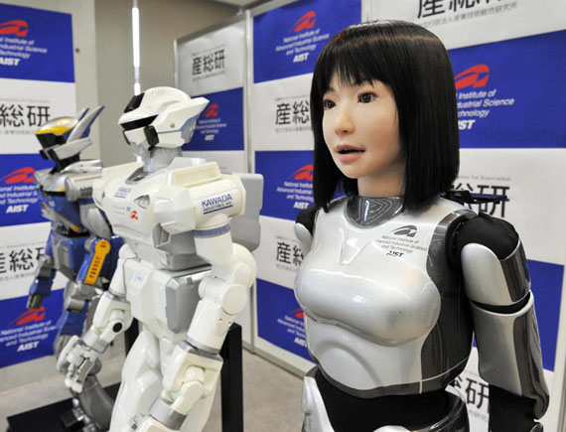
Overview
Robots in Society
Problem Statement for Transportation
Information on Driverless Cars
Research Project/Purpose
Components Selection
“Making Things Work”
Difficulties
Conclusion
http://www.geekgaz.com/goto/miscellaneous/hrp-4c-fashion-model-robot/

Slide 3
Robots in Society
Designed to substitute humans for dangerous, repetitious or arduous tasks.
Mining
Farming
Construction
First Response (Rescue/Firefighting) [M.A.S.T.]

Slide 4
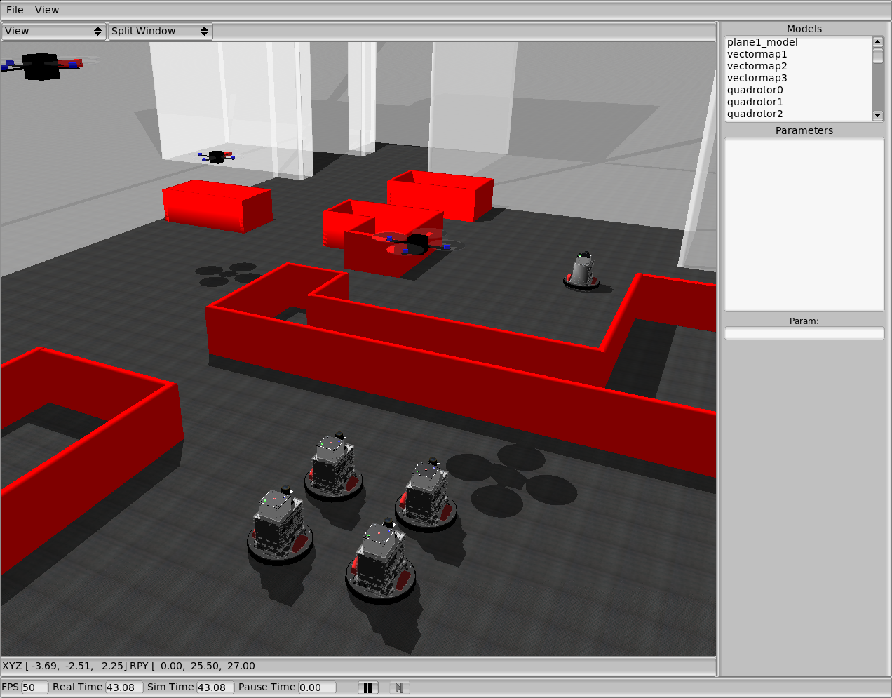
M.A.S.T. Simulation
https://alliance.seas.upenn.edu/~kumar/wiki/index.php?n=Main.MASTSimulation

Slide 5
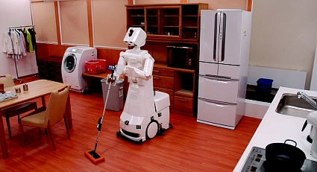
Robots in Society
Designed to substitute humans in daily chores.
Housekeeping/Grounds-keeping
Cooking household meals
Other errands
http://www.iheartrobotics.com/2009/01/robots-from-university-of-tokyos-irt.html

Slide 6
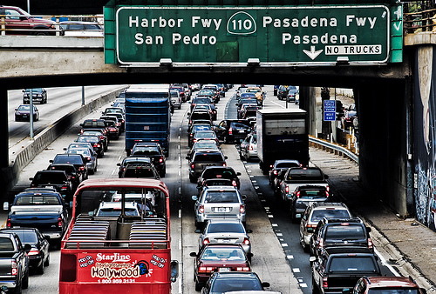
Problem Statement
Unnecessary Traffic Accidents
2004 – 2009: over 63 million accidents in the U.S. alone
Traffic accidents account for 14% of all deaths in U.S.
Billions of dollars worth of damage every year
http://www.flickriver.com/photos/trash-photography/3238595745

Slide 7
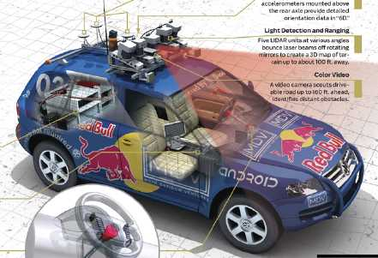
Autonomous Driving
Fewer crashes
Increased parameters
Relief of driving and navigation chores
Handicapped
Elimination of redundant passengers
Alleviation of parking scarcity
Less vehicles worldwide
Reduction in traffic police and vehicle insurance
http://superpositioned.com/files/stanley.jpg

Slide 8
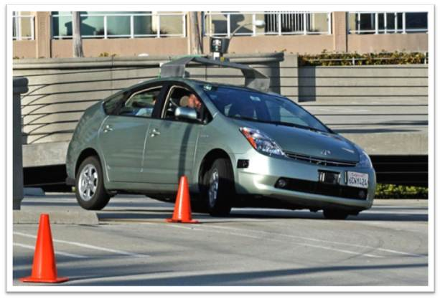
Google’s Prius
http://en.wikipedia.org/wiki/Autonomous_car

Slide 9
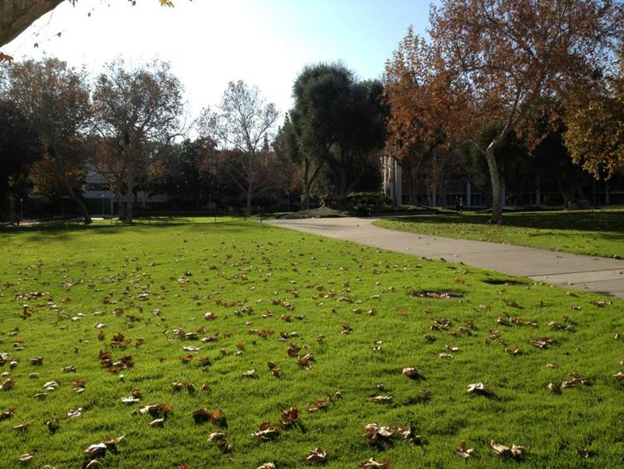
Research Project
Design an autonomous robot that can complete a course through the quad area of California Polytechnic State University: Pomona, that is able to stay on course without driving into anything.
Quad at Cal Poly Pomona. Taken by: Chris Ohara. Spring 2012

Slide 10
Purpose
Raise awareness about robotics
Lay the foundation for future projects
Push the limits of technology available to the public

Slide 11
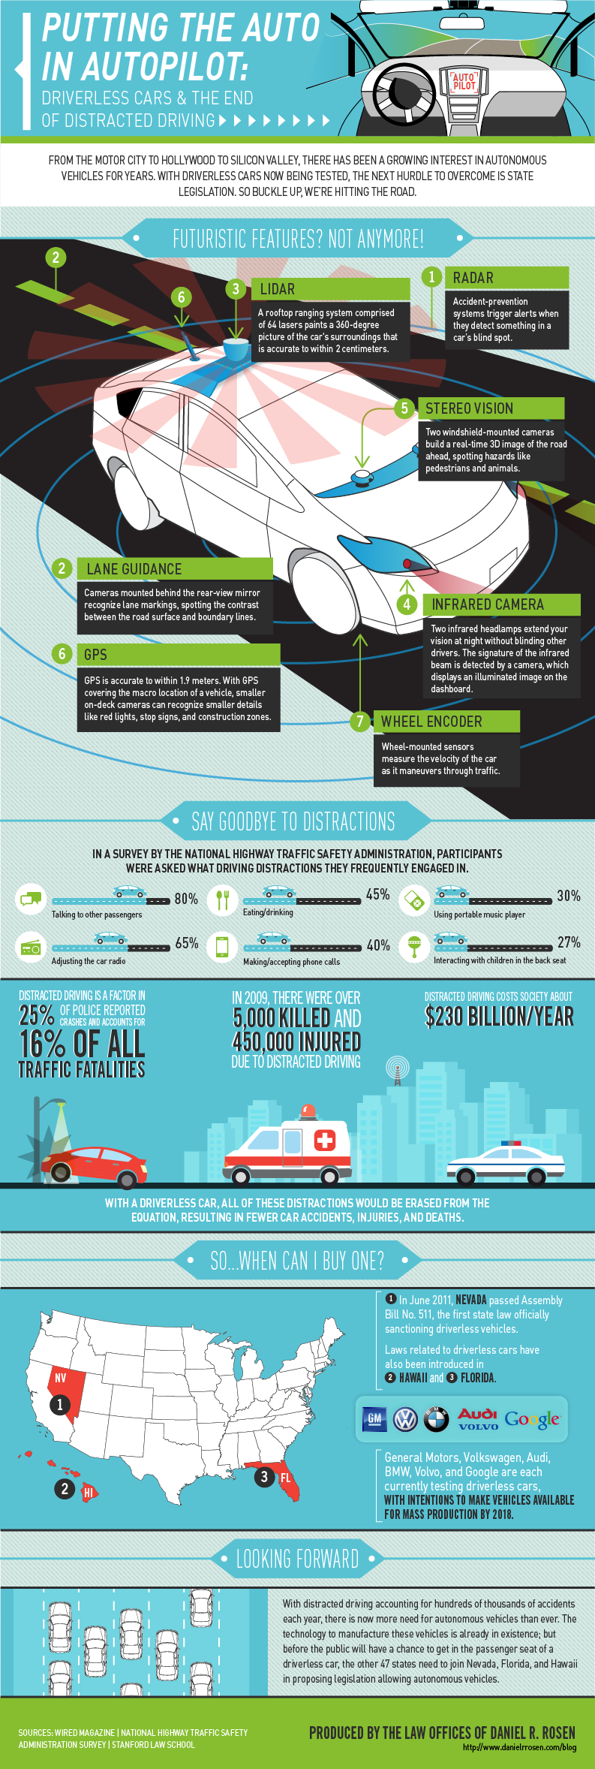
Original Parts List
Chassis
Motors
Batteries
Microcontroller
Motor Shields
GPS Receiver/Board
RC Receiver/Transmitter

Slide 12
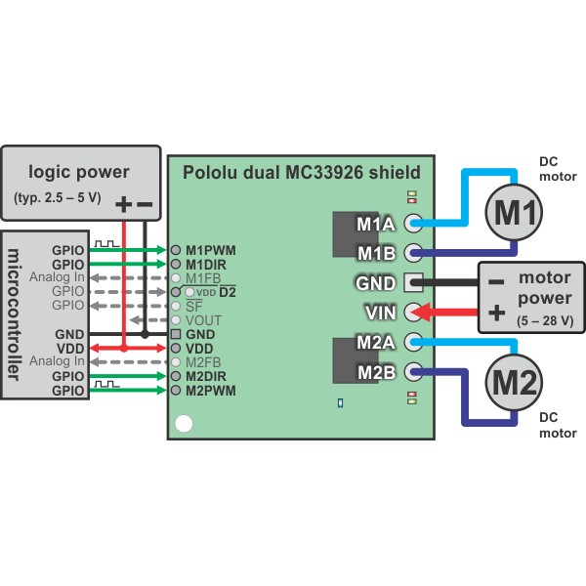
Components Selection
Compatibility
Communication
Interaction
Reliability
Field Testing
Heavy Usage
Availability
Non-Discontinued
Replication
http://www.pololu.com/docs/0J55/4.b

Slide 13
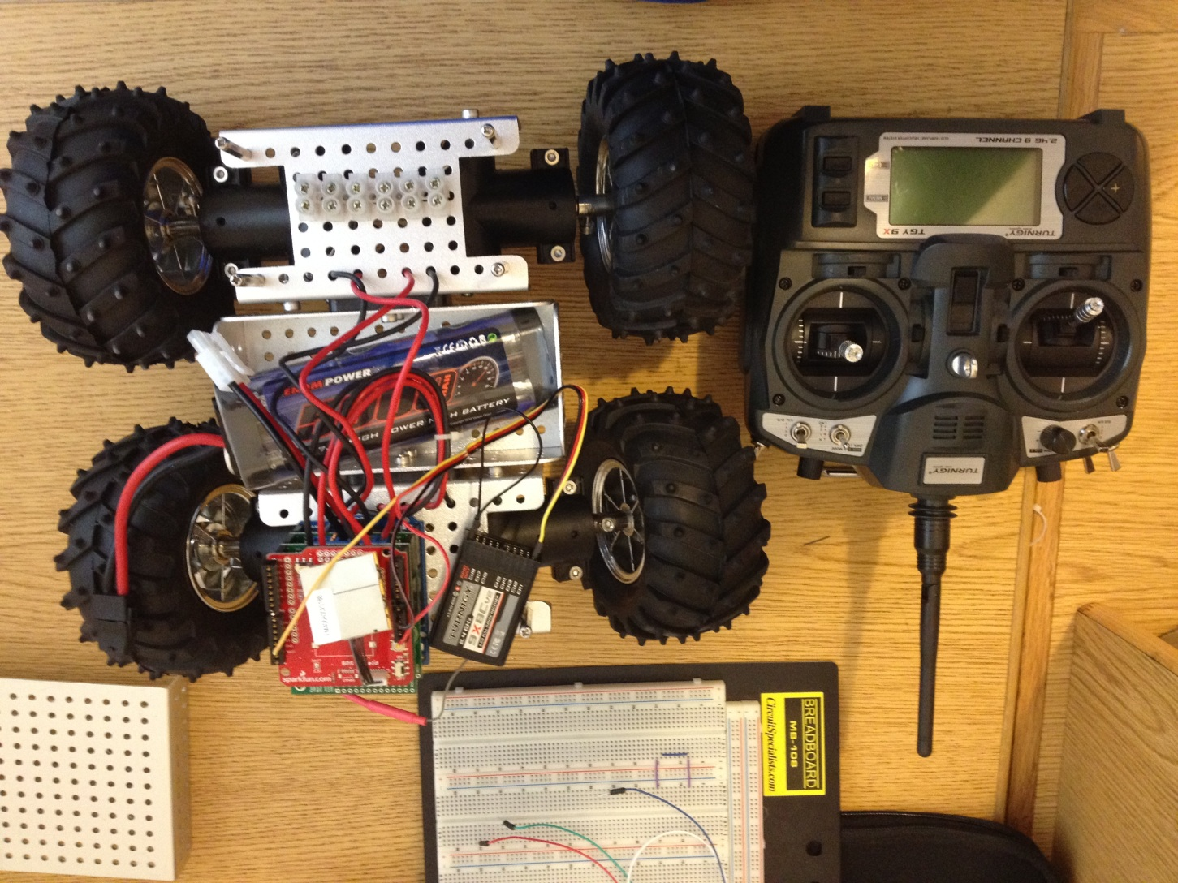
Parts
Taken by: Chris Ohara. Summer 2012

Slide 14
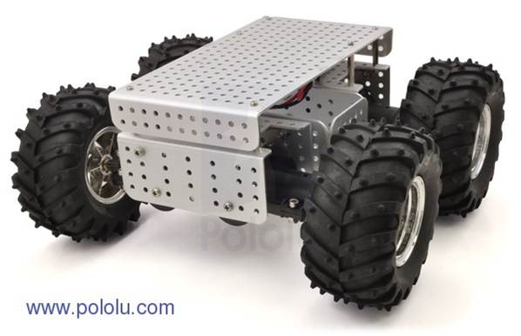
Chassis & Motors
Requirements & Specifications-
Maximum Velocity/Torque
Maneuverability
Acceptable Voltage/Current Ranges
Ability to Attach/Interface with Circuitry

Slide 15
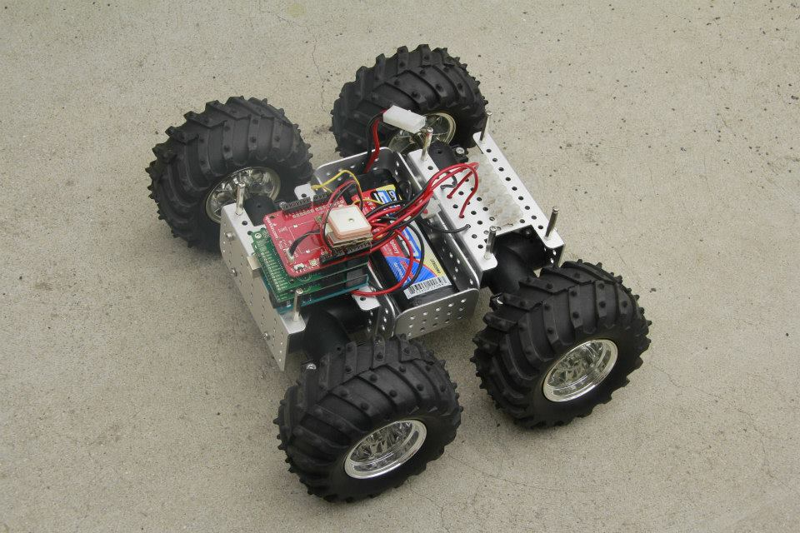
Mk. I Robot

Slide 16

Arduino
www.arduino.cc

Slide 17
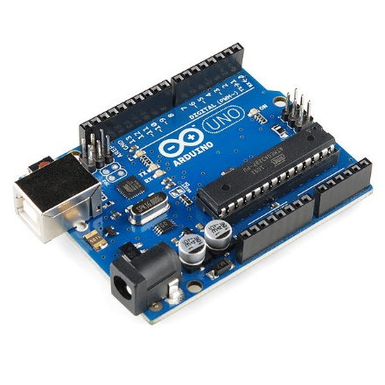
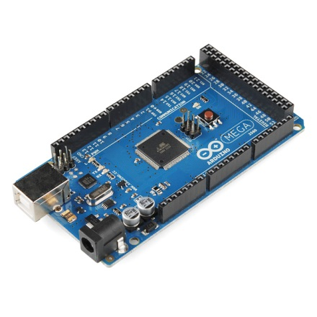
Controller Selection
Arduino
Open Source code
Available free to everyone
Shields
Stacking of components
Reliable
Hundreds of projects
Support
Many forums and libraries
https://www.sparkfun.com/products/11021
https://www.sparkfun.com/products/11061

Slide 18
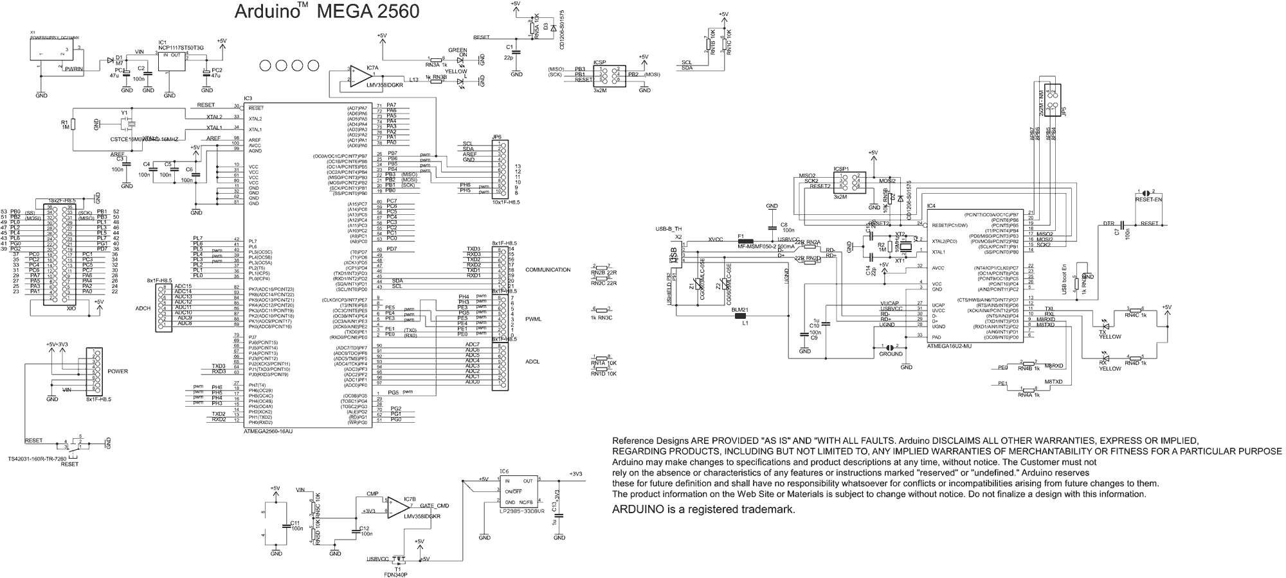
Arduino MEGA 2560
http://atmega32-avr.com/wp-content/uploads/2012/06/arduino_mega_2560_schematic.gif

Slide 19
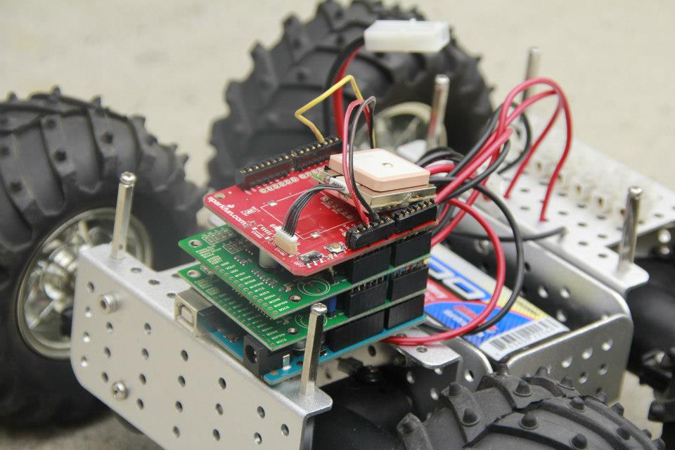
“Shield Stacking”
Taken by: Chris Ohara. Summer 2012

Slide 20
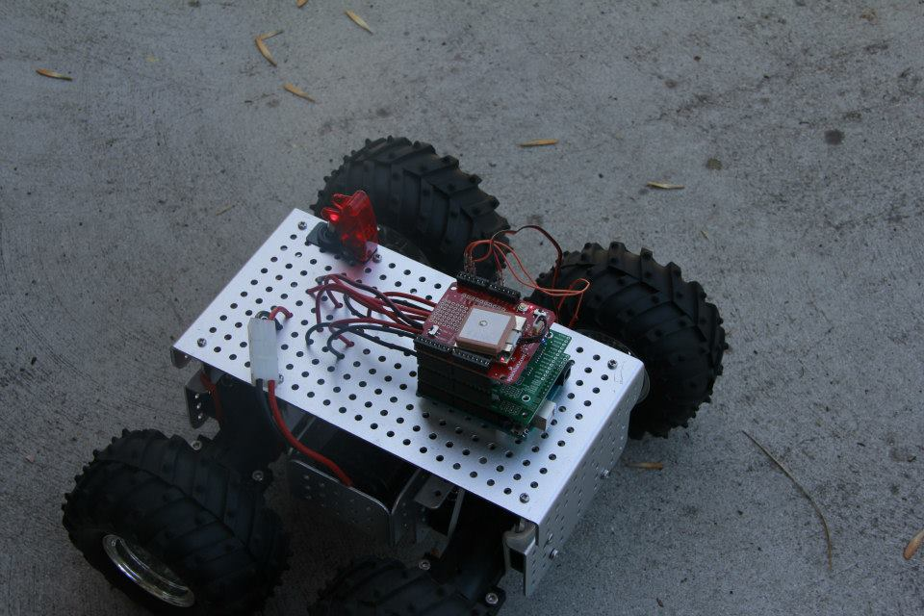
Mk.II Complete
Taken by: Daniel Barnes. Spring 2013

Slide 21
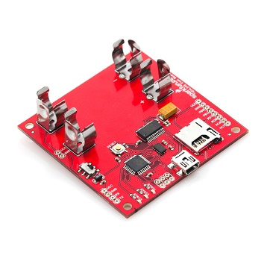
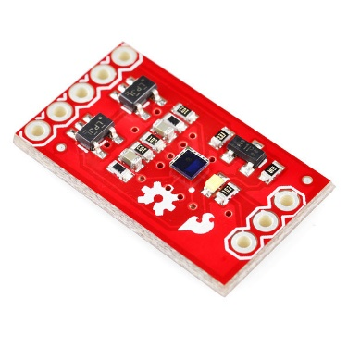
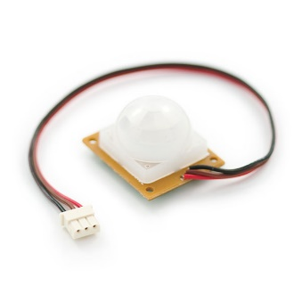
Recent Parts Addition
Accelerometer
Precisely measures velocity
Color/Light Sensor
Able to measure subtle differences
in color
PIR Motion Sensor
An infrared motion detector to detect
people and animals
https://www.sparkfun.com/categories/23

Slide 22
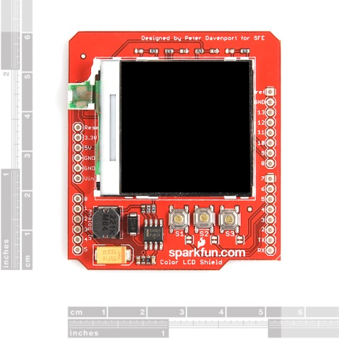
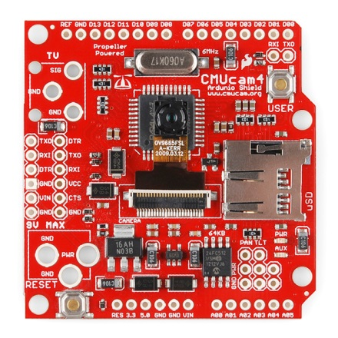
Recent Parts Additions
LCD
Display to show data
Computer Vision
Able to interpret light/color with onboard
image processing

Slide 23
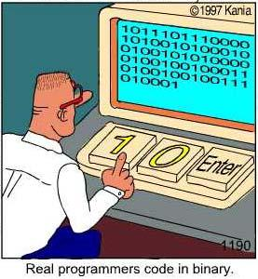
Coding
Arduino uses its own specialized code
Uses a C/C++ base formatting of code
Some projects integrate Java and Python
Structure
Setup(), void(), Loop()
Variables
High, Low, Input
Functions
pinMode(), digitalWrite()
www.kulfoto.com

Slide 24
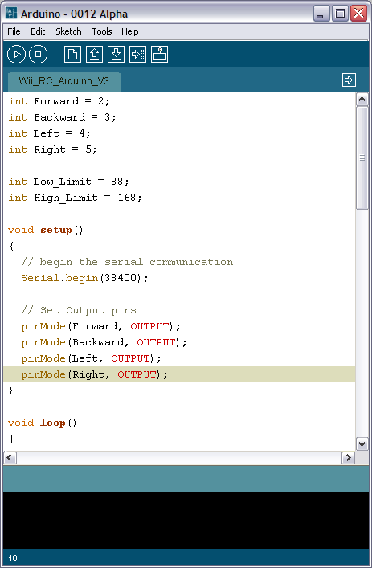
Arduino Sketch
Taken by: Chris Ohara. Summer 2012

Slide 25
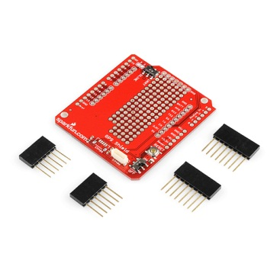
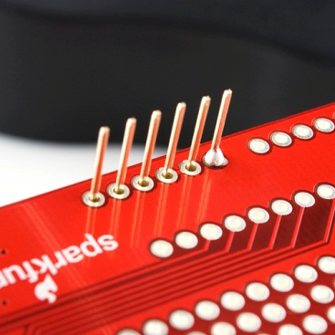
Shield Assembly
http://www.sparkfun.com/tutorials/184

Slide 26
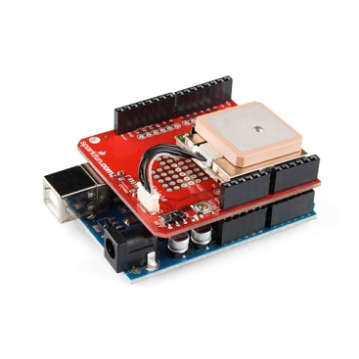
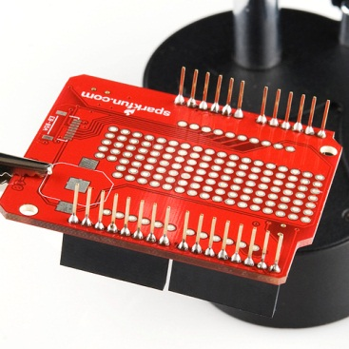
GPS Assembly Completed
http://www.sparkfun.com/tutorials/184

Slide 27
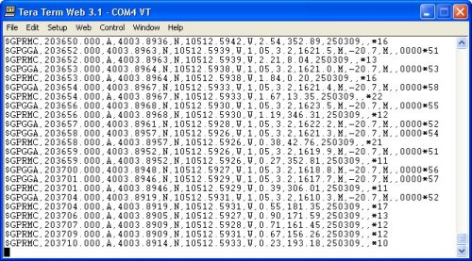
Coordinates Input
http://www.geo.uib.no/eworkshop/index.php?n=Main.Edgetech3100

Slide 28
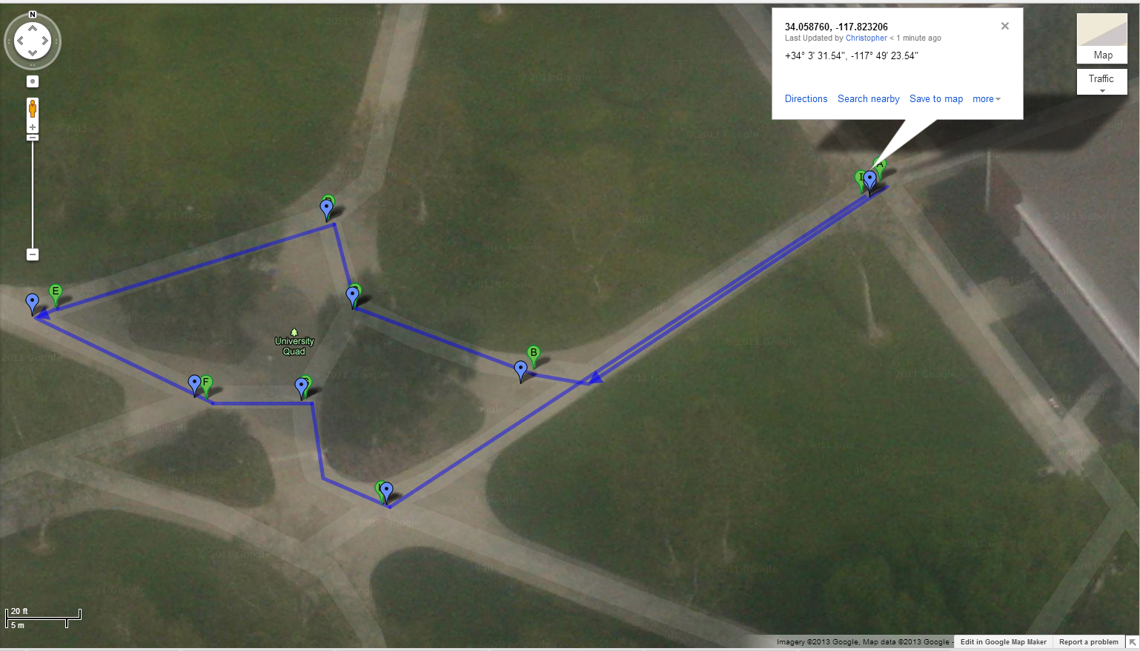
Google Maps
www.google.maps.com

Slide 29
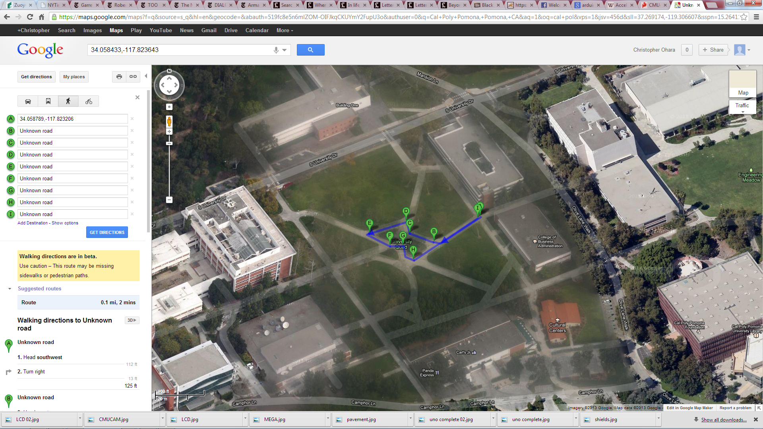
Google Maps
www.googlemaps.com;
www.google.maps.com

Slide 30
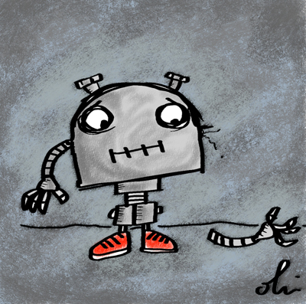
Issues
Parts Communication
Obsolete drivers, voltage differences, connectivity
Coding
Uploading
Parts Failure
Accuracy of products
http://debbieohi.com/home/2012/1/23/daily-drawing-broken-robot.html

Slide 31
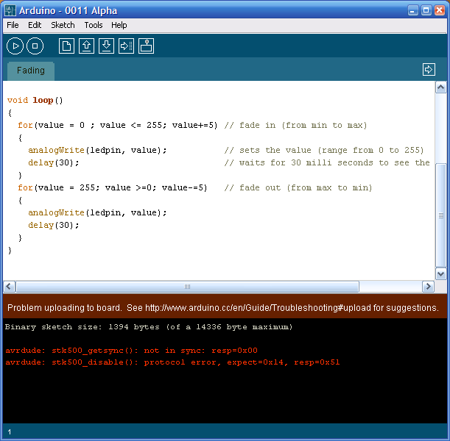
Sketch Error
Taken by: Chris Ohara. Summer 2012

Slide 32
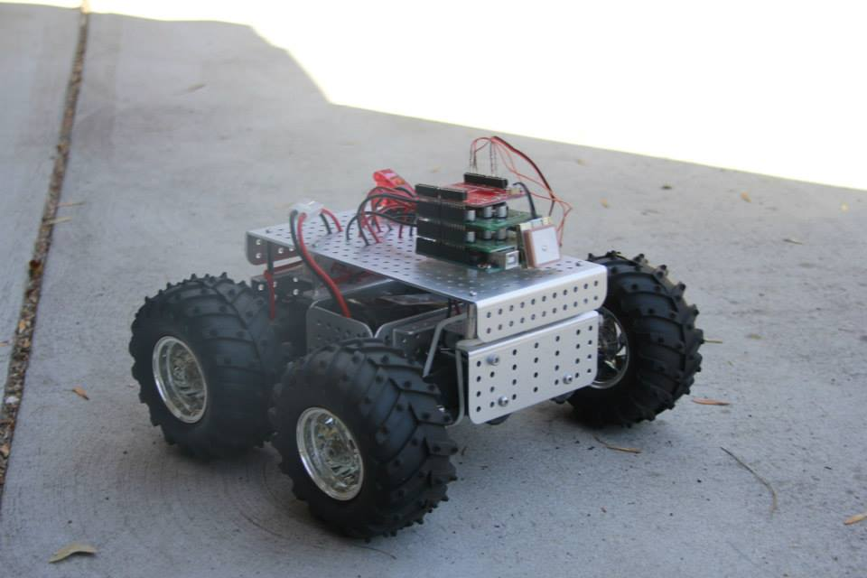

Conclusion
Results
Robot is operational
Robotics is Fun!
http://piroxknow.blogspot.com/2010/12/yuhuuuuuuu-to-everybody.html

Slide 33
Acknowledgements
The Ronald E. McNair Post-Baccalaureate Achievement Program
The Kellogg Undergraduate Scholars Program
Professor Thomas Thoen
Professor Gerald Herder
Daniel Barnes

Slide 34

Questions?
Thank you for your attention!

Slide 35
References
www.polulu.com
www.sparkfun.com
www.allelectronics.com
http://www.sparkfun.com/tutorials/184
http://4micro.files.wordpress.com/2011/08/arduino_sketch.png
www.arduino.cc
www.googleearth.com
http://www.census.gov/compendia/statab/2012/tables/12s1103.pdf
http://www.dmv.ca.gov/about/profile/rd/resnotes/accident.htm
http://www.dyna-vision.de
http://en.wikipedia.org/wiki/Autonomous_car
http://www.nytimes.com/2011/05/29/business/economy/29view.html?_r=1
http://books.google.com/books?id=1I8Wuv7P13AC
http://editorial.autos.msn.com/article.aspx?cp-documentid=1179150
http://www.flickriver.com/photos/trash-photography/3238595745
http://www.geekgaz.com/goto/miscellaneous/hrp-4c-fashion-model-robot
https://alliance.seas.upenn.edu/~kumar/wiki/index.php?n=Main.MASTSimulation
http://www.pololu.com/docs/0J55/4.b
http://www.sparkfun.com/tutorials/184
http://piroxknow.blogspot.com/2010/12/yuhuuuuuuu-to-everybody.html
http://www.geo.uib.no/eworkshop/index.php?n=Main.Edgetech3100
http://www.iheartrobotics.com/2009/01/robots-from-university-of-tokyos-irt.html

